Slide 1
Current Technology
CS274
Prof. Ann Marie Schilling

Slide 2
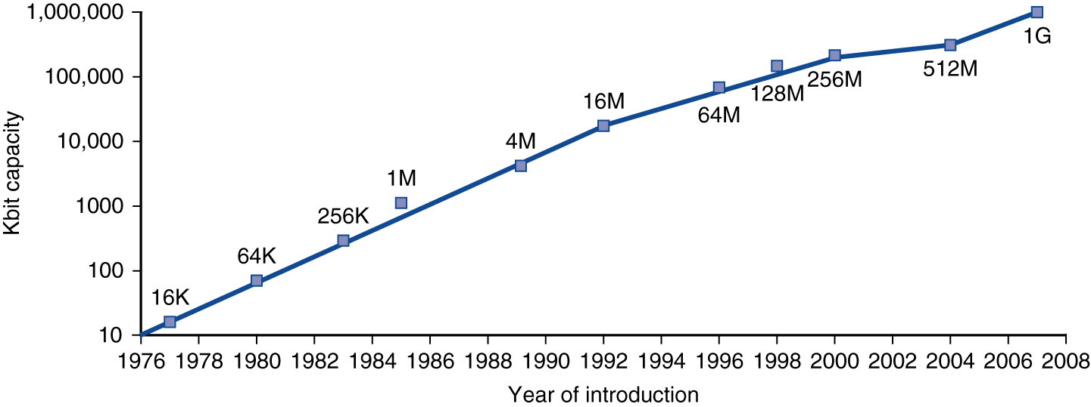
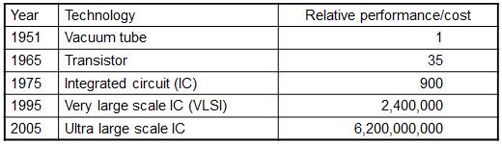
Technology Trends
Electronics technology continues to evolve
Increased capacity and performance
Reduced cost
DRAM capacity

Slide 3
Response Time and Throughput
Response time
How long it takes to do a task
Throughput
Total work done per unit time
e.g., tasks/transactions/… per hour
How are response time and throughput affected by
Replacing the processor with a faster version?
Adding more processors?

Slide 4
Measuring Execution Time
Elapsed time
Total response time, including all aspects
Processing, I/O, OS overhead, idle time
Determines system performance
CPU time
Time spent processing a given job
Discounts I/O time, other jobs’ shares
Comprises user CPU time and system CPU time
Different programs are affected differently by CPU and system performance

Slide 5
CPU Clocking
Operation of digital hardware governed by a constant-rate clock
Clock period
Clock (cycles)
Data transfer and computation
Update state
Clock period: duration of a clock cycle
e.g., 250ps = 0.25ns = 250×10^{–12}s
Clock frequency (rate): cycles per second
e.g., 4.0GHz = 4000MHz = 4.0×10⁹Hz

Slide 6
Performance Summary
The BIG Picture

Slide 7
Multiprocessors
Multicore microprocessors
More than one processor per chip
Requires explicitly parallel programming
Compare with instruction level parallelism
Hardware executes multiple instructions at once
Hidden from the programmer
Hard to do
Programming for performance
Load balancing
Optimizing communication and synchronization

Slide 8
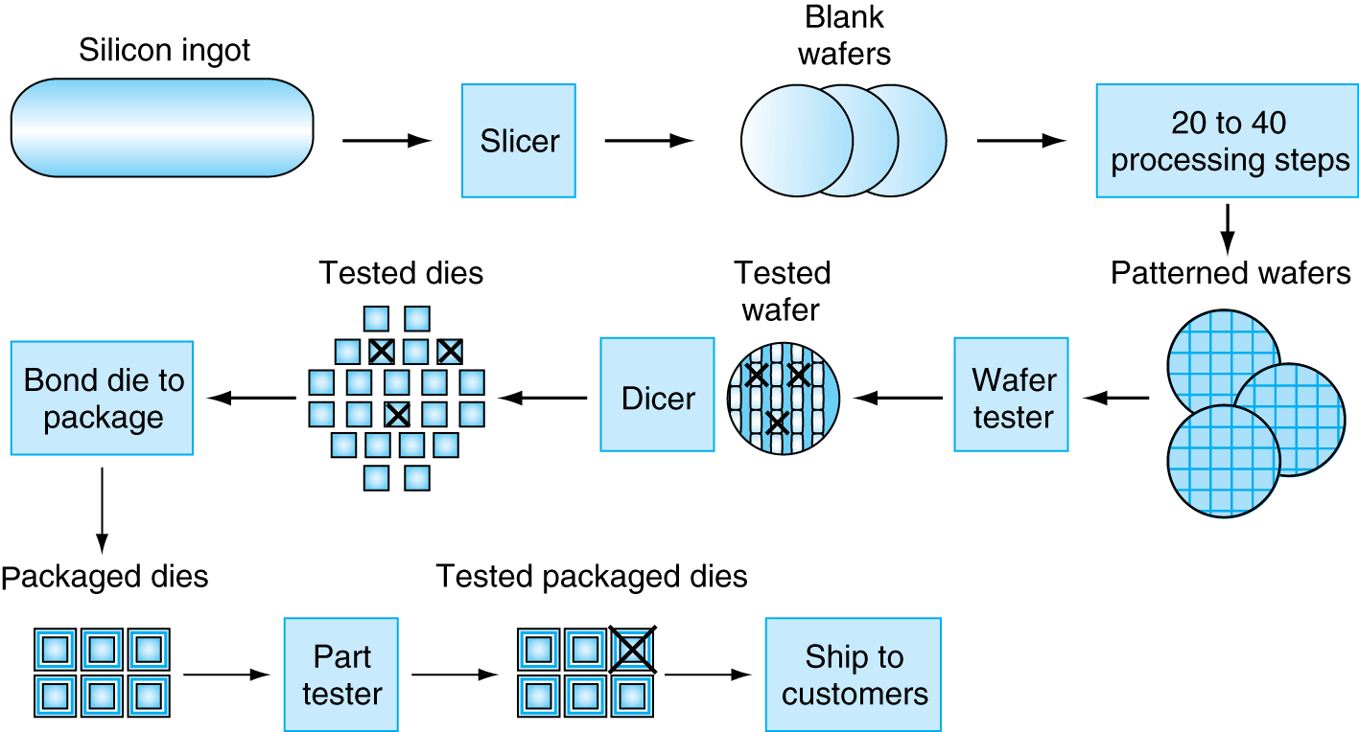
Manufacturing ICs
§1.7 Real Stuff: The AMD Opteron X4
Yield: proportion of working dies per wafer

